Slide 1
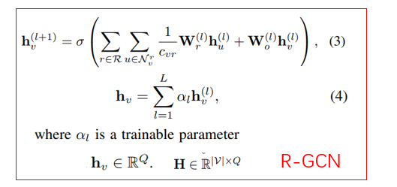
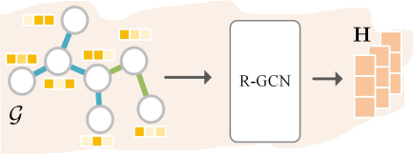
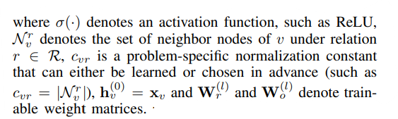
2023_AAAI_Multi-relational Contrastive Learning Graph Neural Network for Drug-drug Interaction Event Prediction

Slide 2




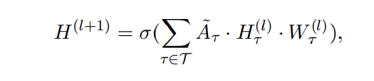




2019_EMNLP_Heterogeneous Graph Attention Networks for Semi-supervised Short Text Classification
Heterogeneous Graph Convolution
A: adjacency matrix
GCN
HIN
={${\text{τ}}_{1}$, ${\text{τ}}_{2}$, ${\text{τ}}_{3}$} express different types of nodes
the submatrix of
Consider the fusion of multiple heterogeneous relationships

Slide 3
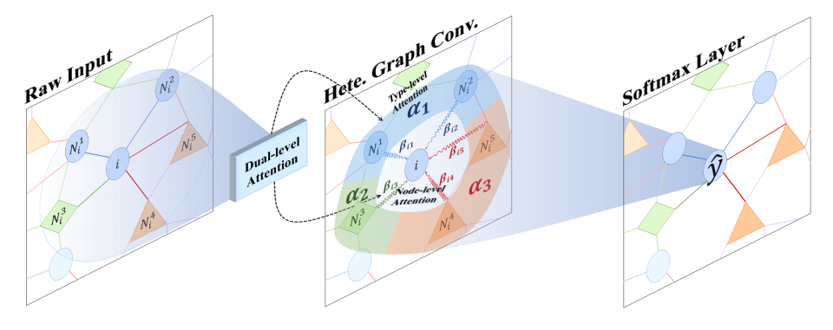



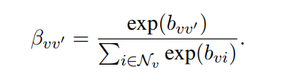
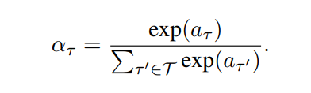
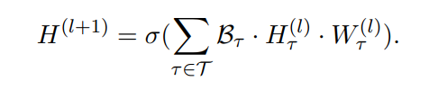
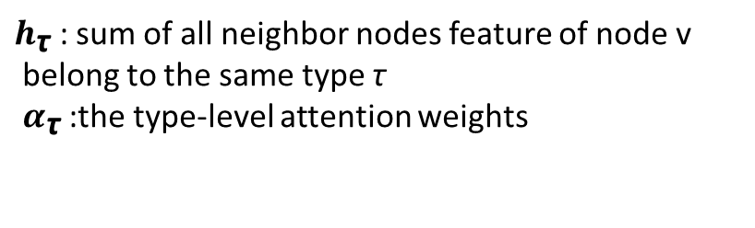
2019_EMNLP_Heterogeneous Graph Attention Networks for Semi-supervised Short Text Classification
Dual-level Attention Mechanism
Type-level Attention
Node-level Attention
$h_{\text{τ}}$ : sum of all neighbor nodes feature of node v
belong to the same type τ
$α_{\text{τ}}$ :the type-level attention weights

Slide 4

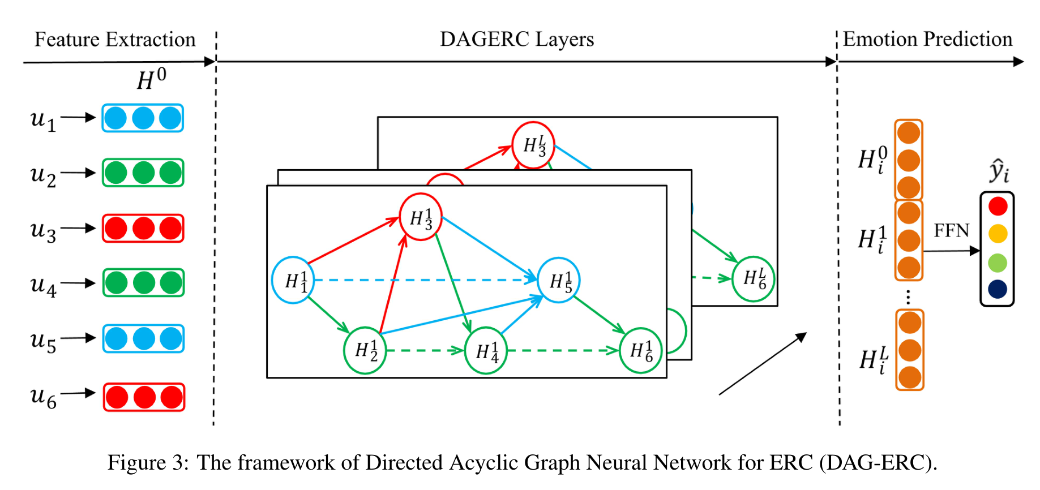
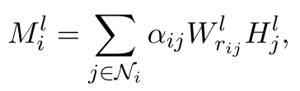


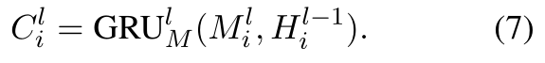


2021_ACL_Directed Acyclic Graph Network for Conversational Emotion Recognition
DAG-ERC Layers

Slide 5
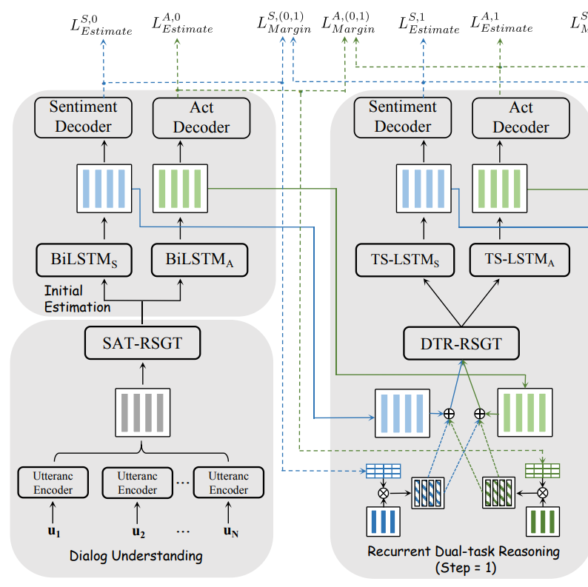
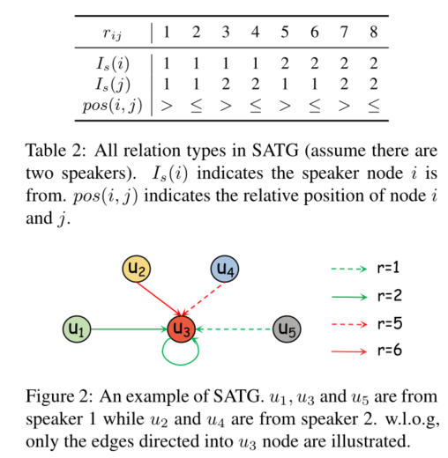

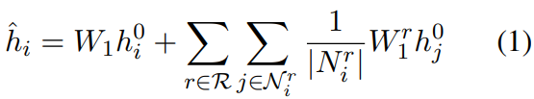

2022_ACL_DARER：Dual-task Temporal Relational Recurrent Reasoning Network for Joint Dialog Sentiment Classification and Act Recognition
Speaker-aware Temporal relation-specific graph transformations
Speaker-aware Temporal RSGT

Slide 6
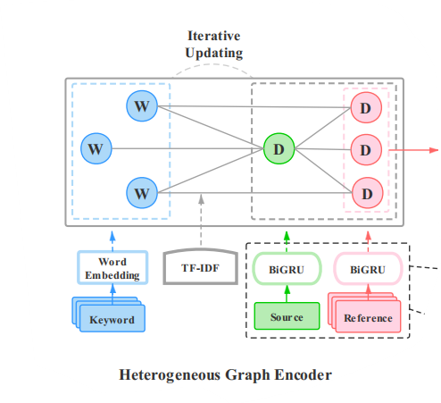
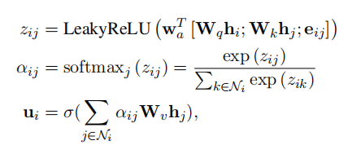
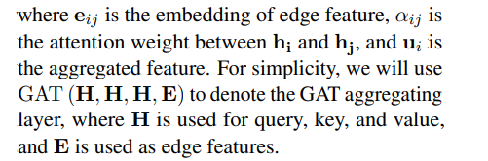
AAAI_2022_Heterogeneous Graph Neural Networks for Keyphrase Generation

Slide 7
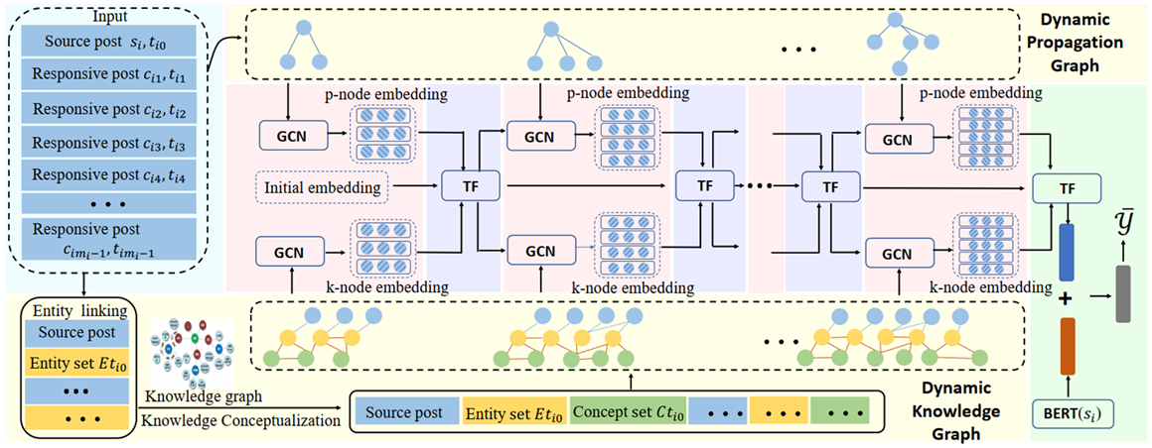
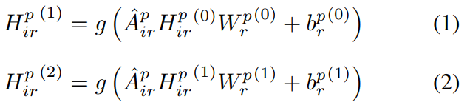





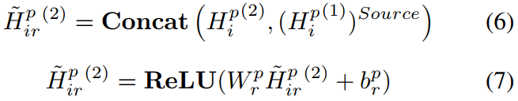
Dual-Dynamic GCN Module
AAAI_2022_DDGCN: Dual Dynamic Graph Convolutional Networks for Rumor Detection on Social Media
A single Dual-Static GCN unit

Slide 8
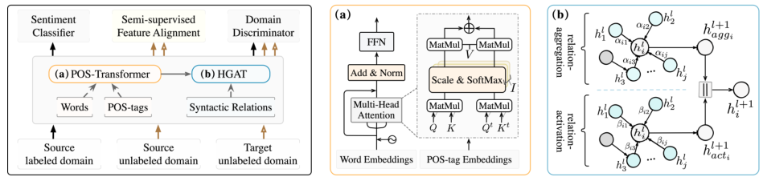
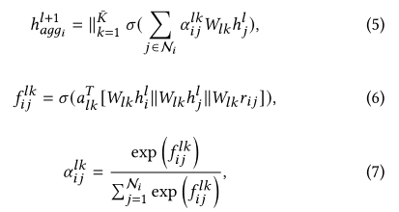
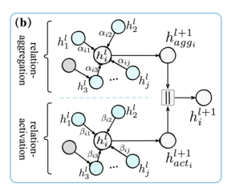
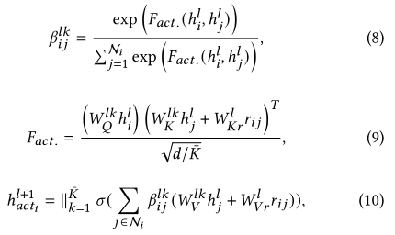

2022_SIGIR_Graph Adaptive Semantic Transfer for Cross-domain
Sentiment Classification
参考知识图谱
Notes:
L第l层，k是第k个头
（11）句子的最后表述是句子中每个单词表示的平均汇总结果。由于HGAT能够计算自适应句法图中相邻词之间的相关性，因此可以充分学习句法结构中包含的可转移语义特征。

